Slide 1
The Design of Optimising Compilers
CS5214
Wong Weng Fai
COM2-03-56
wongwf@comp.nus.edu.sg

Slide 2
Learning objectives
The backend flow of a typical compiler
Machine-independent analysis and optimizations
Machine-dependent analysis and optimizations
Exposing parallelism

Slide 3
Logistics (1)
Lecturer:
Associate Professor Wong Weng Fai
Office: COM2-03-56
Tel: 6516-6902
Email: wongwf@nus.edu.sg

Slide 4
Logistics (2)
Lectures:
Fridays 6.30-8.30pm, SR@LT19
Hit by one public holiday:
Good Friday on 25 March 2016
Coping strategy:
E-Lecture as a replacement

Slide 5
Assessment
Four individual take home assignments (10% each)
Paper presentation (10%)
Final exam (50%)
Thursday, 30 April 2016, PM
Venue to be determined later

Slide 6
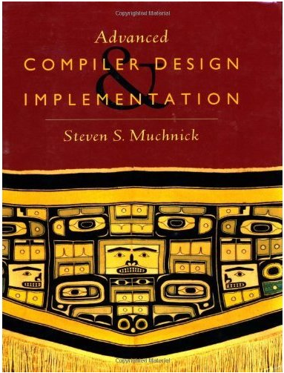
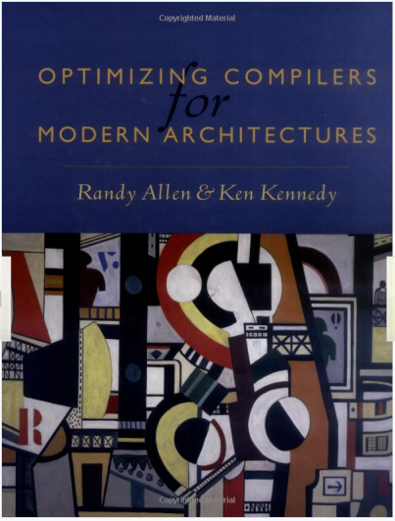
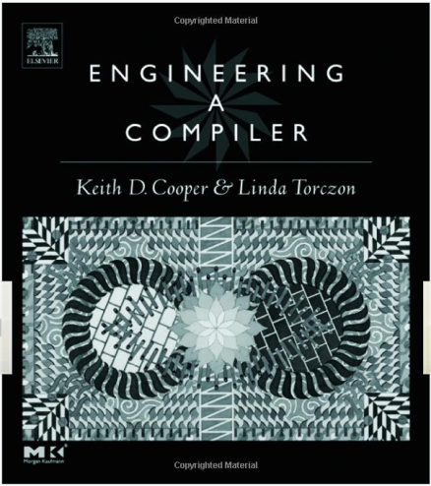
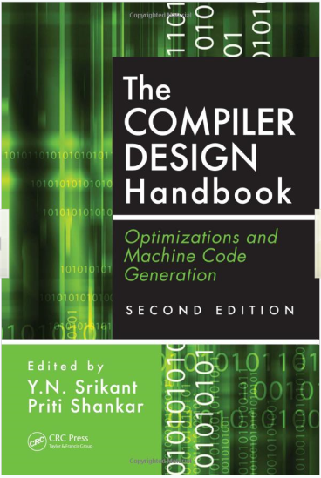
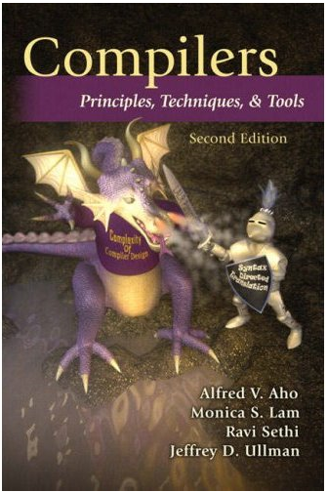
Texts

Slide 7
IVLE
Lecture slides, assignments, etc. all will be distributed and managed via IVLE
Use the discussion forums to share notes and ideas

Slide 8
Why study CS5214?
Enable you to modify a compiler
Know how to work the compiler better
What it CAN and CANNOT do
Write better code (for performance)

Slide 9
What you will learn
Control and data flow analysis
And their applications
Instruction scheduling and register allocation
Compiling for parallelism
Compiling for vector processors
Compiling for the memory hierarchy
Advanced code generation techniques

Slide 10
Compiler Preliminaries

Slide 11
Structure of Optimizing Compilers
TOOLS
Source Program
Source Program
Front
ends
Front-end #1
Program
Database
Front-end #2
…..
High-level Intermediate Language
HIL
High-level
Optimizer
Middle
end
Optimized HIL
Lowering of IL
Low-level Intermediate Language
LIL
Back
ends
Low-level
Optimizer
Optimized LIL
Target-1
Code Generator
and Linker
Target-2
Code Generator
and Linker
Target-3
Code Generator
and Linker
…..
Runtime
Systems
Target-1 Executable
Target-2 Executable
Target-3 Executable

Slide 12
Front-end
Scanner
Parser
Semantic Analysis

Slide 13
Scanner
Convert characters (letters) into tokens (words)
Sort out keywords from user introduced variables

Slide 14
Languages
An alphabet is a set of symbols
A string is a sequence of symbols of an alphabet
A language is a set (possibly infinite) of strings

Slide 15
Examples
Human languages
Sentences are strings
Computer programs are strings of a language – a programming language

Slide 16
The Recognition Problem
Given a string S and a language L, is S ∈ L ?

Slide 17
Languages and Machines
Each (formal) language has a corresponding (abstract) machine that recognizes it
A language is characterized by its machines
It is recognized by the machine
The machine generates a language of that class

Slide 18
The Four Classes
Regular Languages, RL
Finite state automata
Context Free Languages, CFL
Push-down automata
Context Sensitive Languages, CSL
Linear bounded automata
Recursively Enumerable Languages, REL
Turing machines

Slide 19
Chomsky’s Hierarchy
RL ⊂ CFL ⊂ CSL ⊂ REL
strict subset!

Slide 20
Church’s Thesis
The Turing machine is equivalent in computing power to all computers and the most general notions of computations

Slide 21
Undecidability
There exist problems for which no Turing machine can halt and return an answer
There are unsolvable problems in this universe!
Don’t confuse this with NP-completeness

Slide 22
Finite State Automata
A finite state automata is a quintuple, M = (Q, Σ, δ, q₀, F) such that
Q is a set of states
Σ is an input alphabet
δ is the transition function
q₀ is the initial state
F is the set of final states

Slide 23
An extension
By definition, δ (q, s) = p where q and p are states and s is a symbol in Σ
However, we shall extend it strings over Σ, i.e. δ (q, S) = p where S = s₀s₁…s_{n}, s_{i} ∈ Σ, by δ (q, s₀s₁…s_{n}) = δ (δ (q, s₀), s₁…s_{n})

Slide 24
Deterministic FSA (DFA)
A FSA is deterministic if and only if the transition function, δ, maps each pair of (q, s) to exactly one state in Q

Slide 25
Non-deterministic FSA (NFA)
A FSA is non-deterministic if and only if the transition function, δ, maps each pair of (q, s) to a set of states (possibly empty) each of which is from Q

Slide 26
Regular Languages
A string x is said to be accepted by finite automaton, M = (Q, Σ, δ, q₀, F) if δ (q₀, x) = p for some p in F
The language accepted by M, designated L(M), is the set {x | δ (q₀, x) is in F}
A language is a regular set if it is accepted by some finite automaton

Slide 27
Regular Expressions
For a regular expression r, the language L(r) = { all the strings that match r }
L((a | ε) · b) = {“ab” “b”}
Suppose r and s are regular expression denoting languages L(r) and L(s)
L(r | s) = L(r) U L(s)
L(r · s) = { xy | x ∈ L(r) and y ∈ L(s) }
L(r*) = { x₁ x₂ ... x_{k} | x_{i} ∈ L(r) and k >= 0 }
L(ε) = {}

Slide 28
Regular Expressions
We know:
L(r | s) is the union of L(r) and L(s)
L(r · s) is the concatenation of L(r) and L(s)
L(r*) is the Kleene closure of L(r)
“zero or more occurrence of”

Slide 29
The Fun Part
DFA = NFA = Regular Expressions
A FA with multiple initial states = NFA
A 2-way DFA (2DFA) which can move one step to the left or right of its input = DFA

Slide 30
Non-regular languages
An example: { 0^{i} | i is prime}

Slide 31
Uses of Regular Languages
Lexical analyzers
Editors, grep, in Unix
To specified controllers

Slide 32
Scanner Generators
Automated tools are available
Takes regular expression specifications and convert them to DFAs
Eg.: Lex, Flex, etc.

Slide 33
Parsing
Using tokens (words) recognize syntactic structure of the language
Produce a parse tree
All modern computer languages can be expressed as context-free languages

Slide 34
Context Free Grammar
A context free grammar is a 4-tuple, G = (V, T, P, S)
V is a finite set of non-terminals (also called variables)
T is a finite set of terminals
P is a finite set of production rules (also just simply called productions)
S is a special non-terminal known as the start symbol

Slide 35
Production Rules
Each production rule (also called productions or rewrite rules) is of the form A → α
where A is a non-terminal and is a string of symbols from (V ∪ T)*

Slide 36
Derivation (direct)
If A → β is a production of P and α and γ are strings in (V ∪ T)*, then α A γ ⇒ α β γ
I.e. α A γ directly derives α β γ in grammar G (we will drop the subscript G if the context is obvious)
G

Slide 37
Derivation (general)
If α₁, …, α_{m} are strings of (V ∪ T)*, and α₁ ⇒ α₂ ⇒ … ⇒ α_{m} then we say α₁ ⇒* α_{m} or α₁ derives α_{m}

Slide 38
Language
The language generated by G, L(G), is {w | w in T* and S ⇒* w}
A string of terminals and non-terminals α is in sentential form if S ⇒* α

Slide 39
A Derivation Tree
A tree is a derivation (or parse) tree for a CFG G if:
Every vertex as a label which is a symbol of V ∪ T ∪ {ε}
The label of the root is S
If a vertex is an internal node and has a label A, then A must be in V

Slide 40
Derivation Tree (cont)
If a node has label A, and its descendents, from left to right, has labels X₁, X₂, …, X_{n} then there must be a production in G such that A → X₁ X₂ … X_{n}
If a vertex has label ε, then it must be a leaf and the only descendent of its parent

Slide 41
An Example
Goal
Expr
Expr
-
Term
Term
Term
*
Num
Num
Num
2
2
2

Slide 42
Yield
The yield of a derivation tree is the string of labels of its leaves read from a left-to-right order

Slide 43
Theorem
Let G = (V, T, P, S) be a CFG. Then S ⇒* w if and only if there is a derivation tree in grammar G with yield w.

Slide 44
Leftmost and Rightmost Derivations
If at each step in a derivation a production is applied to the leftmost non-terminal, then the derivation is said to be leftmost.
If at each step in a derivation a production is applied to the rightmost non-terminal, then the derivation is said to be rightmost.

Slide 45
Ambiguity
A context-free grammar such that some word has two parse trees is said to be ambiguous
A context-free language in which every context-free grammar is ambiguous is said to be inherently ambiguous

Slide 46
Inherently Ambiguous CFL
The context-free language L = {a^{n}b^{n}c^{m}d^{m} | n ≥ 1, m ≥ 1} ∪ {a^{n}b^{m}c^{m}d^{n} | n ≥ 1, m ≥ 1} is inherently ambiguous!
very tedious proof…

Slide 47
In practice
As far as programming language processing is concerned, we would like to have non-ambiguous CFLs
If not – hack and hack!

Slide 48
Properties of CFL
CFL are closed under
Union
Concatenation
Kleene closure
Substitution
CFL are not closed under
Intersection
Complementation

Slide 49
Pushdown Automata (PDA)
Just as FSM is to regular languages, the PDA is to CFL
Two equivalent definition of acceptance
The basis for parsers

Slide 50
Definition of PDA
A pushdown automaton M is a system (Q, Σ, Γ, δ, q₀, Z₀, F) where
Q is a finite set of states
Σ is the input alphabet
Γ is the stack alphabet
q₀ in Q is the initial state
Z₀ in Γ is a particular stack symbol called the start symbol

Slide 51
Definition of PDA (cont)
F ⊆ Q is the set of final states
δ is a mapping from Q × (Σ ∪ {ε}) × Γ to finite subsets of Q × Γ*

Slide 52
A Move
The interpretation of
δ(q, a, Z) = {(p₁, γ₁), (p₂, γ₂), …, (p_{m}, γ_{m})}
where q and p_{i}, 1 ≤ i ≤ m, are states, a is in Σ, Z is a stack symbol, and γ_{i} is in Γ*, 1 ≤ i ≤ m, is that the PDA in state q, with input symbol a and Z the top symbol on the stack can, for any i, enter state p_{i}, replace symbol Z by string γ_{i} , and advance the input head one symbol

Slide 53
PDA and CFL
If L is a context-free language, then there exists a PDA M such that L = N(M)
If L = N(M) for some PDA M, then L is a context-free language

Slide 54
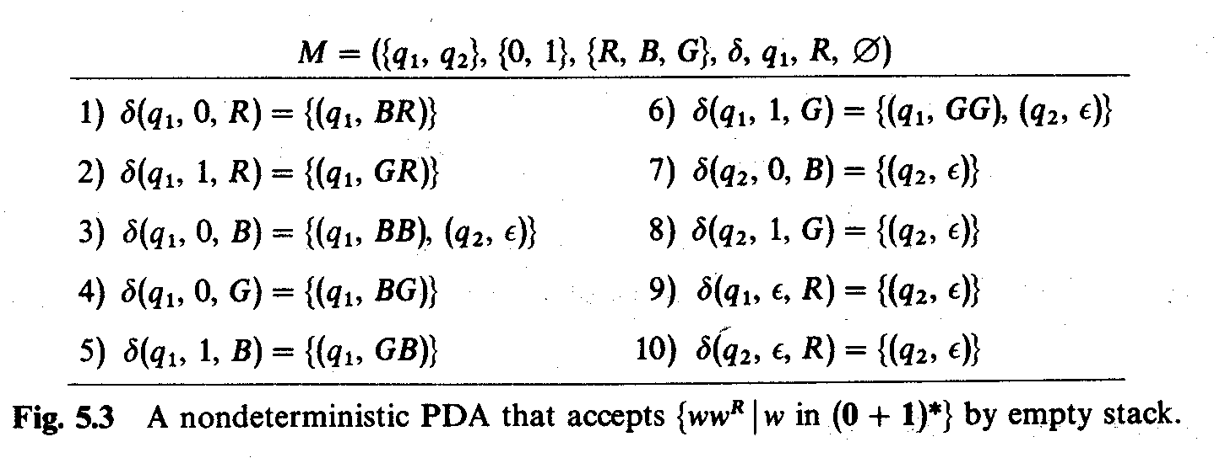
An Example

Slide 55
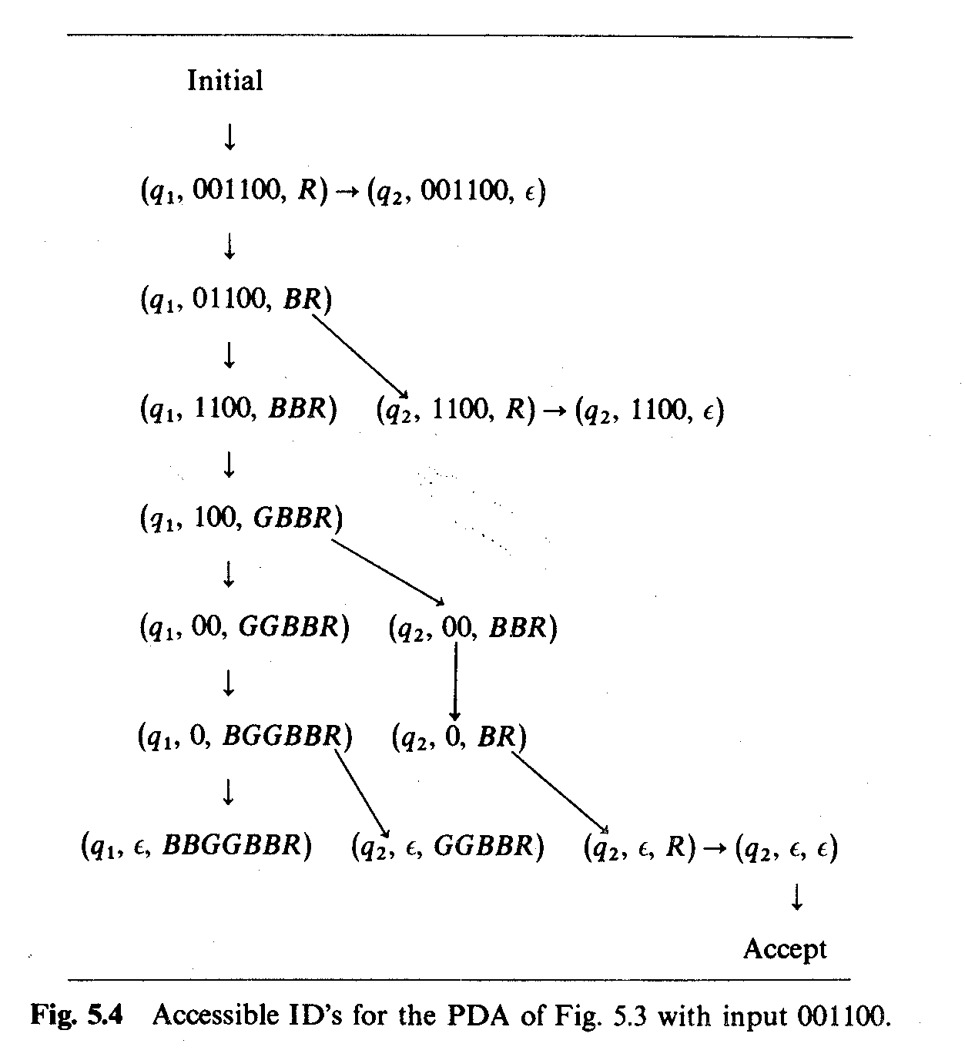

Slide 56
Shift-Reduce Parsing
A simple implementation of deterministic PDA
Consists of a stack for terminals and non-terminals
Three types of actions
Shift
Reduce
Accept

Slide 57
Shift-Reduce Parser
A ← X y Z
X ← a b c
. . .
Production Rules
a
b
c
. . .
Stack
Input Tokens

Slide 58
Shift
The next token of the input is shifted onto the stack

Slide 59
Shift
A ← X y Z
X ← a b c
. . .
Production Rules
a
b
c
. . .
Stack
Input Tokens

Slide 60
Shift
A ← X y Z
X ← a b c
. . .
Production Rules
a
b
c
. . .
Stack
Input Tokens

Slide 61
Reduce
If the top few symbols of the stack match an RHS of a production, one can do a reduction
Pop the RHS from the top of the stack
Push the LHS nonterminal onto the stack

Slide 62
Reduce
A ← X y Z
X ← a b c
. . .
c
Production Rules
b
a
. . .
Stack
Input Tokens

Slide 63
Reduce
A ← X y Z
X ← a b c
. . .
c
Production Rules
b
a
. . .
Stack
Input Tokens

Slide 64
Reduce
A ← X y Z
X ← a b c
. . .
Production Rules
X
. . .
Stack
Input Tokens

Slide 65
Accept
If the input is empty
accept if only the start symbol is on the stack
reject otherwise

Slide 66
Conflicts
Conflicts arose due to ambiguity in grammar
Shift-reduce conflicts
In a certain state, one have two choices – either to shift or to reduce
Reduce-reduce conflicts
Symbols on the stacks can be used to satisfy more than one production rules

Slide 67
Overcoming conflicts
Look ahead
By precedence rules

Slide 68
Parser-Generator
Many automated tools available to generate parsers
Eg. YACC, bison
User specifies a context-free grammar and tool generate a parser
Needs a scanner to feed it tokens

Slide 69
Parsing in Compiling
Ensures that the input program is syntactically correct
Builds internal representation
By “hooks” to production rules

Slide 70
Output of Parsing
Symbol table
User defined variable names, types, and scope
Abstract Syntax Tree
A tree representation of the program

Slide 71
Constructor of Useful Parsers (CUP)
Java-based
Closely resembles YACC
LALR(1) parser-generator
http://www.cs.princeton.edu/~appel/modern/java/CUP/

Slide 72
A CUP Example
expr_list ::= expr_list expr_part | expr_part
expr_part ::= expr ';'
expr ::= expr '+' expr
| expr '-' expr
| expr '*' expr
| expr '/' expr
| expr '%' expr
| '(' expr ')'
| '-' expr | number

Slide 73
Example (cont)
// CUP specification for a simple expression evaluator (no actions)
import java_cup.runtime.*;
/* Preliminaries to set up and use the scanner. */
init with {: scanner.init(); :};
scan with {: return scanner.next_token(); :};
/* Terminals (tokens returned by the scanner). */
terminal SEMI, PLUS, MINUS, TIMES, DIVIDE, MOD;
terminal UMINUS, LPAREN, RPAREN;
terminal Integer NUMBER;
/* Non terminals */
non terminal expr_list, expr_part;
non terminal Integer expr, term, factor;

Slide 74
Example (cont)
/* Precedences */
precedence left PLUS, MINUS;
precedence left TIMES, DIVIDE, MOD;
precedence left UMINUS;
/* The grammar */
expr_list ::= expr_list expr_part |
expr_part;
expr_part ::= expr SEMI;
expr ::= expr PLUS expr
| expr MINUS expr
| expr TIMES expr
| expr DIVIDE expr
| expr MOD expr
| MINUS expr %prec UMINUS
| LPAREN expr RPAREN
| NUMBER
;

Slide 75
Invoking CUP
java java_cup.Main < parser.cup
Generates two files
parser.java
The parser
sym.java
The symbols used by the parser

Slide 76
Further extensions
// CUP specification for a simple expression evaluator (w/ actions)
import java_cup.runtime.*;
/* Preliminaries to set up and use the scanner. */
init with {: scanner.init(); :};
scan with {: return scanner.next_token(); :};
/* Terminals (tokens returned by the scanner). */
terminal SEMI, PLUS, MINUS, TIMES, DIVIDE, MOD;
terminal UMINUS, LPAREN, RPAREN;
terminal Integer NUMBER;
/* Non-terminals */
non terminal expr_list, expr_part;
non terminal Integer expr;
/* Precedences */
precedence left PLUS, MINUS;
precedence left TIMES, DIVIDE, MOD;
precedence left UMINUS;

Slide 77
Further extensions
expr ::= expr:e1 PLUS expr:e2
{: RESULT = new Integer(e1.intValue()+e2.intValue()); :}
| expr:e1 MINUS expr:e2
{: RESULT = new Integer(e1.intValue()-e2.intValue()); :}
| expr:e1 TIMES expr:e2
{: RESULT = new Integer(e1.intValue()*e2.intValue()); :}
| expr:e1 DIVIDE expr:e2
{: RESULT = new Integer(e1.intValue()/e2.intValue()); :}
| expr:e1 MOD expr:e2
{: RESULT = new Integer(e1.intValue()%e2.intValue()); :}
| NUMBER:n
{: RESULT = n; :}
| MINUS expr:e
{: RESULT = new Integer(0 - e.intValue()); :}
%prec UMINUS
| LPAREN expr:e RPAREN
{: RESULT = e; :}
;

Slide 78
The Scanner
User is responsible in supplying the scanner
Advice: use JLex

Slide 79
The Scanner
scanner should implement the java_cup.runtime.Scanner interface
package java_cup.runtime;
public interface Scanner {
public Symbol next_token() throws java.lang.Exception;
}

Slide 80
Interfacing with JLex
All you need is 3 lines
%implements java_cup.runtime.Scanner
%function next_token
%type java_cup.runtime.Symbol

Slide 81
Invoking the parser
Invoking the parser with the JLex scanner is
parser parser_obj = new parser( new Yylex( some_InputStream_or_Reader));

Slide 82
Abstract Syntax Tree
a = b*c + b*d + b*c is represented as
=
a
+
*
+
b
c
*
*
b
c
b
d

Slide 83
Concrete vs Abstract Syntax
Assignment statement
A := B; (Pascal)
A = C; (C)
(setq A B) (Lisp)
etc.
Abstract
assign
expression
variable
variable
A
B

Slide 84
Semantics Checking

Slide 85
Semantics Checking
Programs, like human sentences, may be grammatically correct but totally meaningless (semantically)

Slide 86
Examples
Type checking
Type agreement, in practice, catches a great number of programming errors
Variable declaration and scoping

Slide 87
Code Optimization

Slide 88
Code Optimization
Preserve correctness
Improve performance
Two main categories:
High level optimizations
Low level optimizations

Slide 89
High Level Optimization
Machine independent
May be intra-procedural or inter-procedural
May operate on the source level or the abstract syntax tree or the lower intermediate code

Slide 90
Low Level Optimization
Machine dependent
Usually only intra-procedural
Deals with the lowest level intermediate representation or machine code
Most important: register allocation and instruction scheduling

Slide 91
Code Generation

Slide 92
Code Generation
After low level optimizations, IR would be lowered to near machine code level
Actual generation of machine code depends on the IR used

Slide 93
Low level IRs
Many low level IRs (eg. GCC) are so low that there is almost a one-one correspondence between the IR and machine code

Slide 94
Example: GCC
(insn 8 24 10 (set (reg:SI 7 %esp)
(plus:SI (reg:SI 7 %esp)
(const_int -12 [0xfffffff4]))) 205 {addsi3+1} (nil)
(nil))
(insn 10 8 12 (set (mem:SI (pre_dec:SI (reg:SI 7 %esp)) 0)
(symbol_ref:SI ("*.LC0"))) 44 {movsi-2} (nil)
(nil))
(call_insn 12 10 29 (set (reg:SI 0 %eax)
(call (mem:QI (symbol_ref:SI ("printf")) 0)
(const_int 16 [0x10]))) 375 {call_value+1} (nil)
(expr_list:REG_UNUSED (reg:SI 0 %eax)
(nil))
(nil))
Register allocated!

Slide 95
Tree based Approach
“Code Generation Using Tree Matching and Dynamic Programming” - Alfred V. Aho, Mahadevan Ganapathi, and Steven W. K. Tjiang ACM Transactions on Programming Languages and Systems, Vol. 11, No. 4, October 1989, Pages 491-516.

Slide 96
Codegen from tree rewriting
From an abstract syntax tree, we can use tree rewriting to do code generation
Subtrees are replaced with a single node based on pattern matching
Each replacement also generate some code

Slide 97
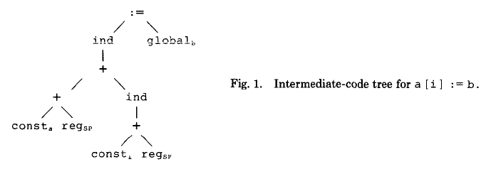
Example

Slide 98
Rewriting Rules
replacement ← template {cost} {action}
“replace the subtree matching template with replacement after you consider the cost and when you do replace, you have to perform action”

Slide 99
Example of a Template
+
reg_{i}
reg_{i}
reg_{k}

Slide 100
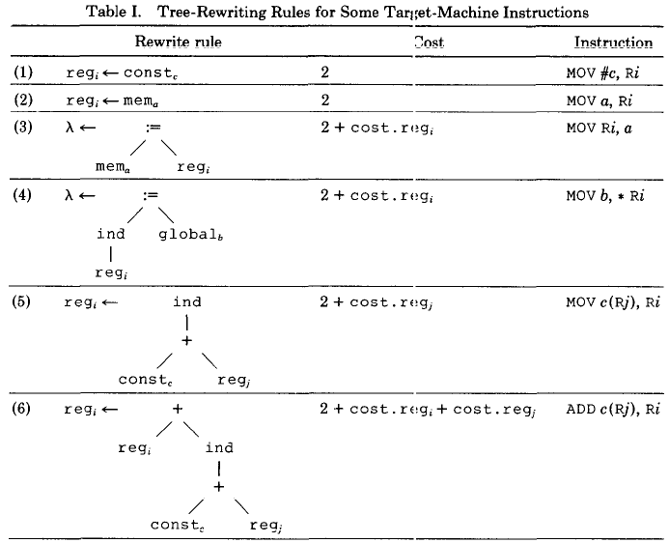

Slide 101
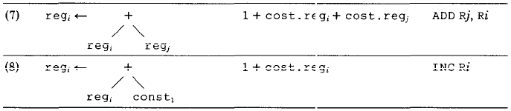

Slide 102
Our Example
:=
ind
global_{b}
+
+
ind
const_{a}
reg_{sp}
+
const_{i}
reg_{sp}

Slide 103
Our Example
mov #a, R0
:=
ind
global_{b}
+
+
ind
(1)
reg₀
reg_{sp}
+
const_{i}
reg_{sp}

Slide 104
Our Example
mov #a, R0
add SP, R0
:=
ind
global_{b}
+
(7)
reg₀
ind
+
const_{i}
reg_{sp}

Slide 105
Our Example
mov #a, R0
add SP, R0
add i(SP),R0
:=
ind
global_{b}
(6)
reg₀

Slide 106
Our Example
mov #a, R0
add SP, R0
add i(SP),R0
mov b, *R0
(6)
λ

Slide 107
On
Costs

Slide 108
Time Complexity of Algorithms
Input size to the program/algorithm, of problem being solved is n
n is the number of bits in the input
Running time is expressed as a function
n → T(n)
In theory, constants are overlooked. So we have the big-Oh notation denoted by O

Slide 109
More on Running Time
T(N) is O(n²) → ∃ constants c₁ , c₂ and c₃ such that for sufficiently large n,
T(n) < c₁n² + c₂n + c₃
Classical examples: Merge sorting and FFT take O(n log n) time

Slide 110
Space Complexity of Algorithms
As before, input size is n
The maximum space needed and utilized during the program's execution is denoted by S(n)
In theory be can once again have the big-Oh notation
For example we can say that S(n) is O(nlog n)

Slide 111
Execution Frequencies

Slide 112
What are Execution Frequencies
Branch probabilities
Average number of loop iterations
Average number of procedure calls

Slide 113
How are Execution Frequencies Used?
Focus optimization on most frequently used regions
region-based compilation
Provides quantitative basis for evaluating quality of optimization heuristics

Slide 114
How are Execution Frequencies Obtained?
Profiling tools:
Mechanism: sampling vs. counting
Granularity = procedure vs. basic block
Compile-time estimation:
Default values
Compiler analysis
Goal is to select same set of program regions and optimizations that would be obtained from profiled frequencies

Slide 115
Example: gprof
gcc –pg <xxx>.c
Execute the code
The file gmon.out will be produced
gprof a.out

Slide 116
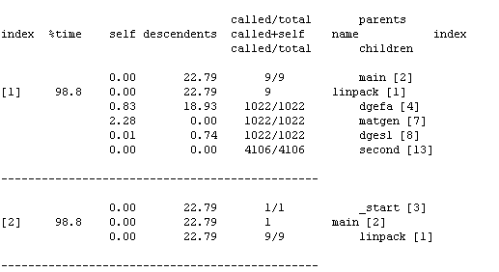
gprof – sample output

Slide 117
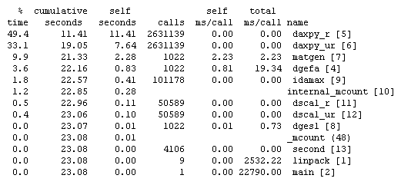
gprof – sample output

Slide 118
What are Execution Costs?
Cost of intermediate code operation
parametrized according to target architecture:
Number of target instructions
Resource requirement template
Number of cycles

Slide 119
How are Execution Costs Used?
In conjunction with execution frequencies:
Identify most time-consuming regions of program
Provides quantitative basis for evaluating quality of optimization heuristics

Slide 120
The “80-20” Rule
The Pareto principle for compilation
80% of the time will be spent in the vital 20% of the code
Key: identify where this 20% is

Slide 121
Hardware Support for Performance Monitoring

Slide 122
Performance Monitoring Hardware
On x86, there are hardware registers for performance monitoring
Performance Monitor Configuration (PMC) registers
Performance Monitor Data (PMD) registers
Selecting, filtering, counting, and reading performance events through the WRMSR, RDMSR, and RDPMC instructions

Slide 123
Higher level tools
Several higher level libraries available for accessing performance monitoring hardware
PAPI
http://icl.cs.utk.edu/papi/
Intel VTune

